Slide 1
E-commerce Task
A task for demonstrating your skills

Slide 2
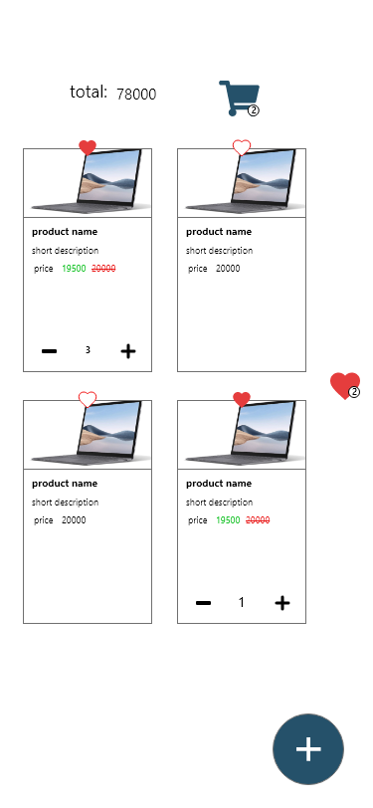
Demo
This is a demo design to demonstrate the features required in this task
It is important to know that you shouldn't copy this design, instead do it differently in your way and you should follow the requirements we put on the job offer
IMPORTANT:
Please read till the last slide
Send task files to this email
fictionteamapps@gmail.com

Slide 3
First page will be a screen with your name and email and phone number with a button that navigates to the app
Name:
Phone:
E-mail:
Run App

Slide 4

Task description
This button navigates to a screen named
‘Add product’ which user can add a new product with all properties
The screen contains a list of components
A button to pick an image from gallery or camera
A list of text fields with required values Such Product name, Product description, and price
A text field for Sale price but will be optional so product can have one or not
A text field for product stock which determines how many products left in the storage
A button to confirm

Slide 5
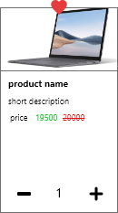
This is product item with all properties
As shown you will display these properties
If the product has a sale price you will show it in green color and strike the price with red color
If it has not you will show the price only in black color
Add and remove button will control the quantity of the product by adding or removing
User can’t add more than the product stock that you determined earlier when you created the product
If the quantity became 0 you will hide the add and remove button with the quantity

Slide 6
If user drag product item to right it will be added to the favorites
Consider updating favorites count and favorites icon for the favorite product

Slide 7

If user drag product item to the top it will be added to the cart
Consider Updating the cart amount and total amount

Slide 8

Cart screen
Will have all products in the cart each product with image, product name, quantity and total price and add with remove button
You can modify quantity or remove item

Slide 9
Favorites Screen
Will have all favorites products and user can remove any of them

Slide 10
How to deliver task
The task will be delivered into an APK and source code added together in a zip file
Name the project with your name and the source code file also
Consider running flutter clean to reduce source code file size before sending it
Send the file to this e-mail
fictionteamapps@gmail.com

